Slide 1
THE
A Journey through Japan’s economic rebirth
Chantal Nyeleti Mashele 221066585
Blessed Colllins-Igbinosa 221050062
Anwar Zain Mohomed 221040318

Slide 2







BACKGROUND
Japan, 2024. The world is looking to Japan, a country known for its resilience, tech innovations, and cultural exports like anime and gaming, to see how it will tackle ongoing economic challenges and how its stock market (the Nikkei) will evolve.

Slide 3



CHARACTERS
1
Hiroshi (The Investor - Protagonist):
Backstory: Hiroshi is a seasoned investor monitoring the Nikkei index since 2014. He has watched the Japanese economy’s ups and downs, learning from the lessons of the post-Fukushima recovery, the rise of new technologies, and Japan’s ageing population.
Goal: To build a portfolio that preserves wealth and positions him ahead of the market by predicting key economic shifts from 2024 to 2030.
2
Akira (The Analyst - Sidekick):
Backstory: Akira is an AI-powered assistant, blending machine learning with market analytics. He represents Hiroshi's connection to futuristic predictive technologies that model data from the Nikkei index.
Role: Akira analyzes historical data from 2014 to 2024, helping Hiroshi make data-driven decisions. He identifies patterns like market cycles, geopolitical influences, and tech disruptions that will likely shape the market by 2030.
Personality: Cool-headed, logical, and data-centric. Akira could visually be inspired by characters like Ghost in the Shell’s Major Motoko Kusanagi, embodying a fusion of technology and humanity.

Slide 4

INVESTING IN OUR NIKKEI PORTFOLIO: A STRATEGIC VISION
In a rapidly evolving global economy, the Nikkei 225 index stands out as a beacon of opportunity for discerning investors. As Hiroshi embarks on his investment journey, his portfolio is not just about numbers; it's a reflection of his commitment to tapping into Japan's robust market potential. Hiroshi’s decision to invest in the Nikkei portfolio is driven by a confluence of factors. Firstly, Japan is home to some of the world’s leading companies, including automotive giants like Nissan and innovative firms like Nippon Steel. These companies are not only pillars of the Japanese economy but also play crucial roles in the global supply chain. By investing in these entities, he positions himseld to benefit from their growth and resilience, especially in sectors that are essential to the future, such as green technology and sustainable manufacturing.
Furthermore, his investment strategy embraces the philosophy of risk parity. He will be investing R100,000 which is approximately 849,000 JPY. By carefully balancing his allocations among various asset classes—like Erste Bank Group and Japan Tobacco—he aims to enhance returns while managing volatility. This approach allows him to navigate the complexities of the market confidently, ensuring that his investments are safeguarded against potential downturns.

Slide 5
INVESTING IN OUR NIKKEI PORTFOLIO: A STRATEGIC VISION
As he looks ahead to 2023/24 and beyond, he recognizes that the Nikkei 225 is more than just an index; it’s a reflection of Japan’s economic recovery and innovation. With trends indicating a strong upward trajectory, he is excited to ride this wave of growth. His portfolio is designed to capture seasonal opportunities and leverage the unique characteristics of the Japanese market, all while maintaining a keen eye on global economic shifts.
In essence, investing in his Nikkei portfolio is not merely a financial decision; it is a strategic alignment with a future filled with potential. He believes that by investing in this diverse and dynamic array of companies, he is not just contributing to his financial growth but also to a more sustainable and innovative economic landscape. Together with Akira, they can embrace the opportunities that lie ahead, creating value for their investment and making a meaningful impact in the world of finance.

Slide 6
DECISION VALUES
MARKET TRENDS AND ECONOMIC FACTORS
·GDP: As of quarter 2, the JPY is at 607.9 trillion, which is ZAR 71.6 trillion, reflecting a steady growth compared to the previous quarters and demonstrating resilience in the economy despite global challenges.
·Japan is currently the world’s third-largest economy, driven by industries such as manufacturing, technology, and exportation.
·Inflation: As of August 2024, the inflation rate is 3.0%, an increase from 2.8%. This affects consumer spending, which can ultimately affect the index.
INDEX PERFORMANCE METRICS
The Nikkei Index has shown a strong uptrend in recent years, with periods of volatility and noticeable gaps between opening and closing prices. Historical price levels may indicate support and resistance areas, offering insights into potential future price movements.
As Hiroshi and Akira have seen how volatile the index is, as any other market would be. With Hiroshi’s investment in this specific index and Hiroshi’sr high-risk tolerance, they are expecting higher returns.

Slide 7
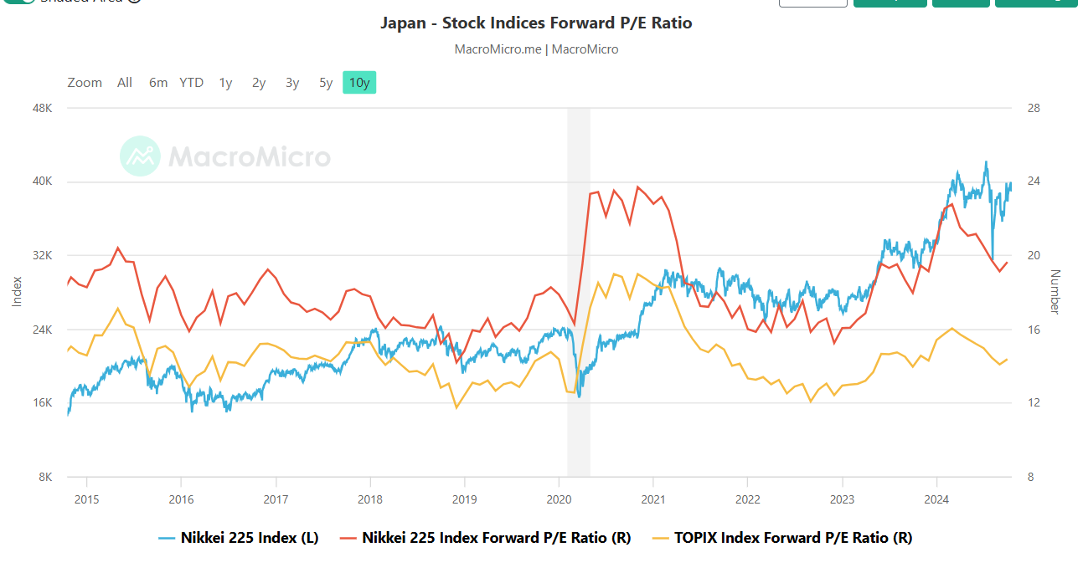
INDEX HISTORY PERFORMANCE
Image obtained from: https://en.macromicro.me/charts/95007/japan-nikkei225

Slide 8
ANALYTICS OF KEY METRICS
Optimal Portfolio Variance: 39,471.54
Optimal Portfolio Volatility (Standard Deviation): 198.67
The standard deviation represents the expected degree of variation in the portfolio's returns. In this case, a standard deviation of 198.67 signifies that the portfolio is subject to substantial price fluctuations. This aligns with Hiroshi’s focus on an extremely volatile environment, where large price swings can create opportunities for higher returns.
The optimal portfolio variance indicates the overall risk associated with the portfolio. Variance measures how much the returns of the portfolio are expected to fluctuate. A higher variance, such as 39,471.54, suggests a more volatile investment environment. This is particularly relevant for Hiroshi’sr strategy, which seeks to capitalize on significant market movements.
Individual Asset Variances:
Each asset's variance is listed below, providing insight into the specific risk profiles of the investments:
Asset 1: 2,163.02 Asset 2: 622,556.39 Asset 3: 2,239.64 Asset 4: 3,708.83 Asset 5: 1,412.44 Among these, Asset 2 exhibits the highest variance at 622,556.39, indicating that it is the most volatile asset in the portfolio. This level of volatility presents opportunities for high returns, which is a key aspect of our investment strategy.
In conclusion, these outputs illustrate the calculated risk and potential return profile of the optimal portfolio. They confirm Hiroshi’s approach to navigating a volatile market, emphasizing Hiroshi’s readiness to embrace fluctuations in pursuit of financial gains.

Slide 9
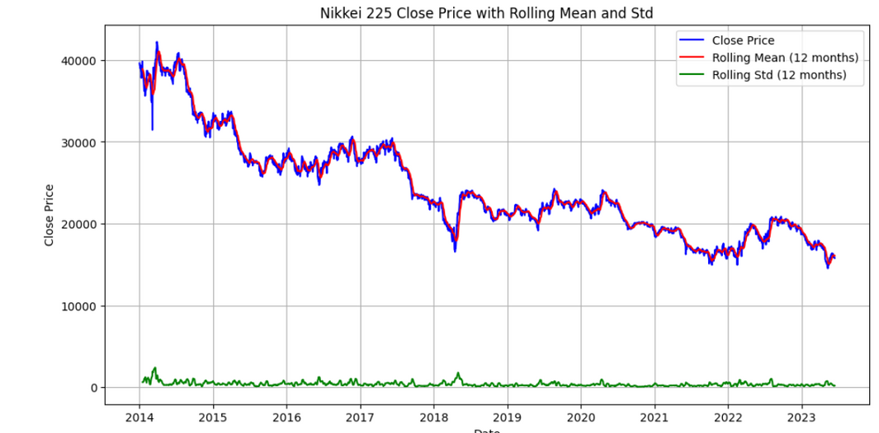
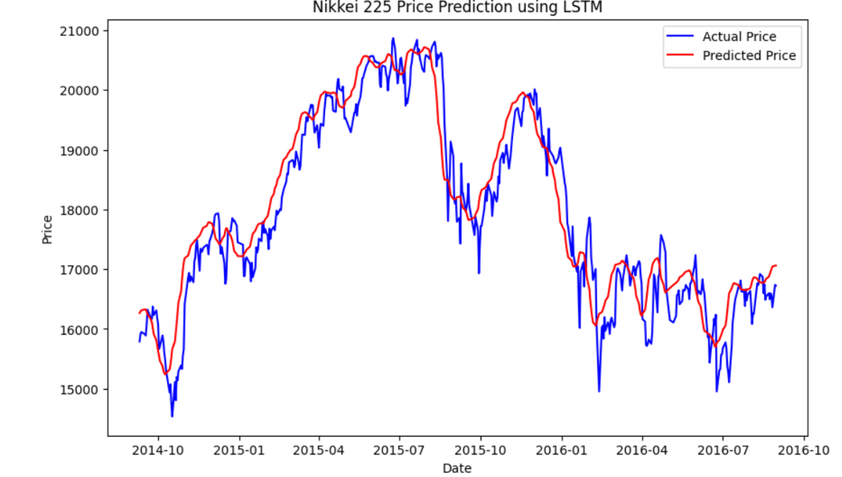
MACHINE LEARNING FORECASTING TECHNIQUES
Volatility:
The index has experienced periods of volatility, particularly in the early years. This suggests that market sentiment and economic factors have significantly influence price movements. Since 2018, after a significant drop in closing prices from 2014, prices started to rise again. However, shortly after that, the world was hit by the pandemic, which was one of the factors that led to prices dropping once more. Some of the contributing factors could be political and climatic.
Distribution:
The distribution of closing prices is skewed to the right, with a longer tail on that side. This indicates a higher probability of extreme events, such as very high or very low prices.
Mean-Reversion:
The analysis suggests potential mean-reversion tendencies in the index. When the price deviates significantly from the mean, it may revert back over time.
Overall Effectiveness of the Model:
The LSTM model demonstrates a solid ability to predict prices, as evidenced by its alignment with actual price trends. This indicates that the model effectively captures long-term patterns in the data, making it a useful tool for forecasting.
Need for Improvement in Short-Term Predictions:
While the model performs well in general, its occasional deviations from actual prices highlight a limitation in capturing short-term fluctuations. This suggests that further refinement is necessary, potentially by incorporating additional features or using different modeling techniques to enhance its responsiveness to sudden market changes.

Slide 10
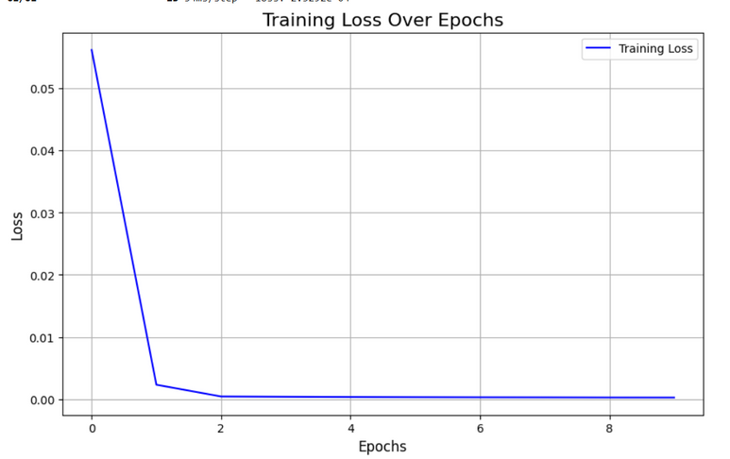
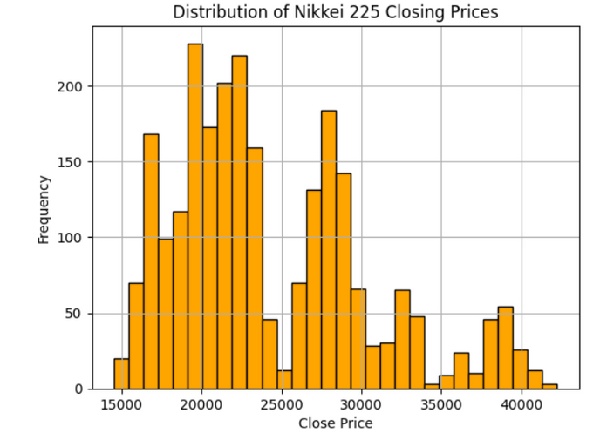

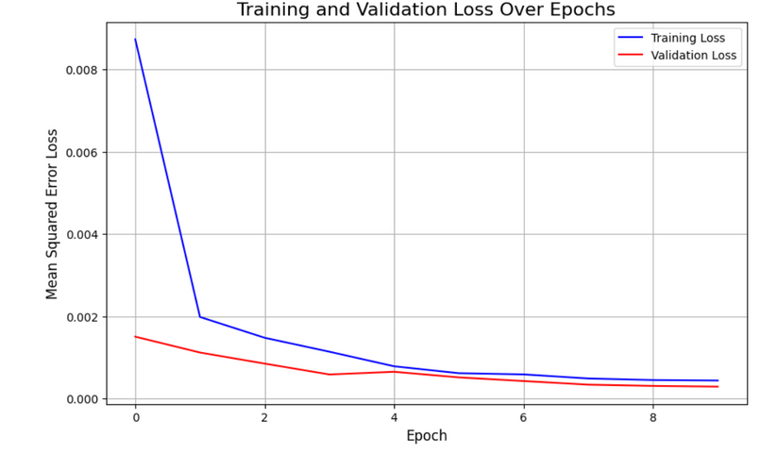
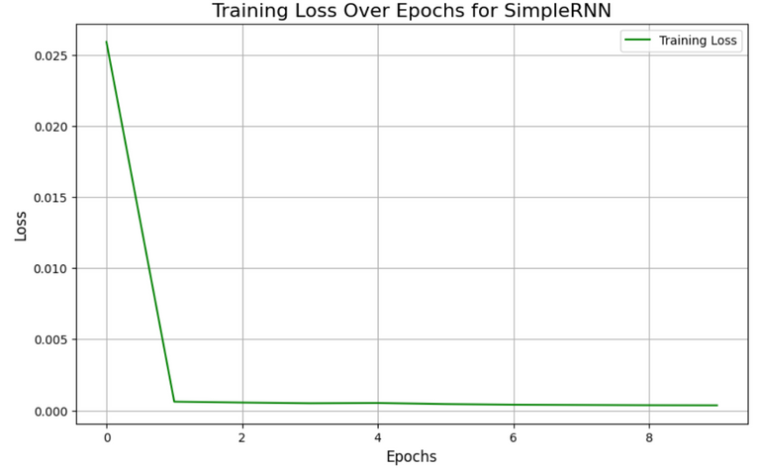
MACHINE LEARNING FORECASTING TECHNIQUES

Slide 11

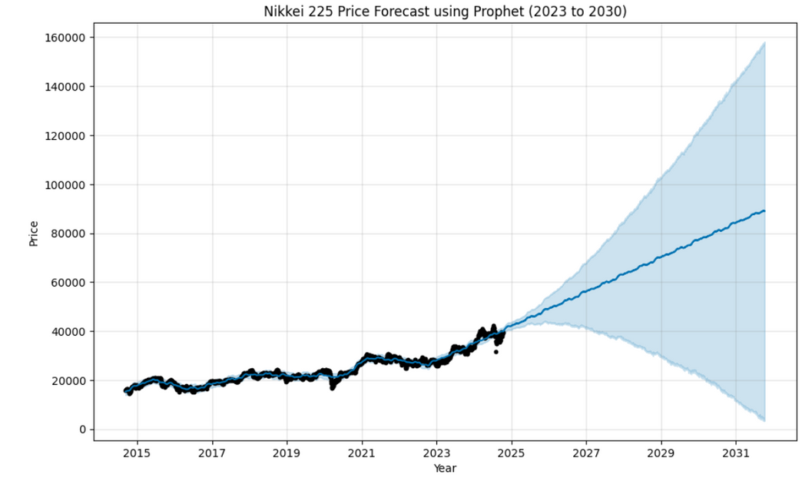

MACHINE LEARNING FORECASTING TECHNIQUES
Trend
Observation:
The model predicts a strong upward trend in the Nikkei 225 price over the forecast period (2023 to 2030).
Analysis:
This suggests a positive outlook for the Nikkei 225, indicating potential capital gains driven by economic recovery, technological advancements, and corporate earnings growth. As an investor, I should consider this trend in my investment strategies, as it reflects favourable long-term market conditions, which is the plan for this investment. To invest for 10 years, and if the economic conditions are still favourable, to continue investing for up to a period of 40 years.
Seasonality
Observation:
The model captures seasonal patterns in the data.
Analysis:
Seasonality in financial markets may arise from investor behavior, fiscal year-end effects, and market cycles. The model’s ability to identify these patterns indicates that certain times of the year may offer better returns. The wider confidence interval during specific periods suggests potential external influences, such as economic events or volatility, affecting market performance during those times.

Slide 12
MACHINE LEARNING FORECASTING TECHNIQUES
Uncertainty
Observation:
The shaded area around the forecast line represents the uncertainty associated with the prediction.
Analysis:
The width of the confidence interval reflects the model's reliability. A wider interval indicates greater uncertainty, potentially due to market volatility or unexpected events. Investors should be cautious, as high uncertainty can lead to risks in decision-making. Understanding this uncertainty enables effective risk management strategies in a volatile market environment.
Holidays
Observation:
The model can incorporate holiday effects into the forecast.
Analysis:
Holiday effects can significantly impact market behavior, often resulting in increased trading volumes and unusual price movements. By accounting for these effects, the model enhances its predictive accuracy, providing investors with insights into potential market fluctuations related to holiday periods.

Slide 13
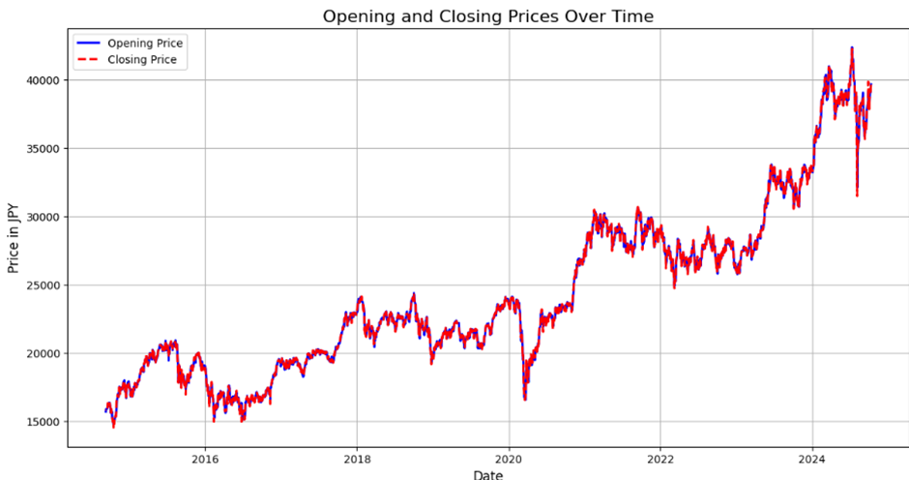
RISK PARITY TESTING
The analysis of a portfolio of five Japanese assets:
Erste Bank Group, Nissan Motor, Nippon Steel, Japan Tobacco, and Mitsui O.S.K. Lines. It calculates the risk parity weights, expected portfolio return, expected portfolio volatility, optimal portfolio variance, and individual asset variances.
Risk Parity Weights:
The weights show how much of the portfolio is allocated to each asset based on their risk levels. In this case, the allocation is heavily concentrated on Erste Bank Group, with negligible or negative weights for the other assets, indicating that Erste Bank Group is perceived as the most favorable investment in terms of risk. Expected Portfolio Return: 3473.72 JPY which would be R29491.88. This value represents the anticipated return from the portfolio based on the current asset weights, suggesting a positive return outlook.

Slide 14
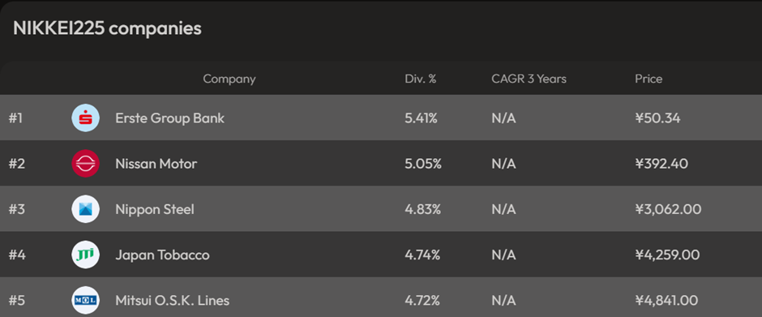
RISK PARITY TESTING
Expected Portfolio Volatility: 8862.04
The expected volatility indicates a high level of risk associated with the portfolio, highlighting potential fluctuations in returns. Optimal Portfolio Variance: 4507015.49. This figure reflects the variability in the portfolio’s returns, indicating a significant level of risk.
Optimal Portfolio Volatility (Standard Deviation): 2122.97
This measures the expected deviation of returns from the average, suggesting that the portfolio is expected to experience considerable fluctuations.
Individual Asset Variances:
Each asset's variance was calculated, with Erste Bank Group and Nissan Motor showing the highest variances, indicating higher risk compared to the others.
Overall, the analysis reveals a portfolio focused on a single asset (Erste Bank Group) with high expected returns but significant volatility, aligning with a strategy aimed at maximizing returns in a volatile environment.
Image obtained from https://dividendpedia.com/nikkei225/:

Slide 15
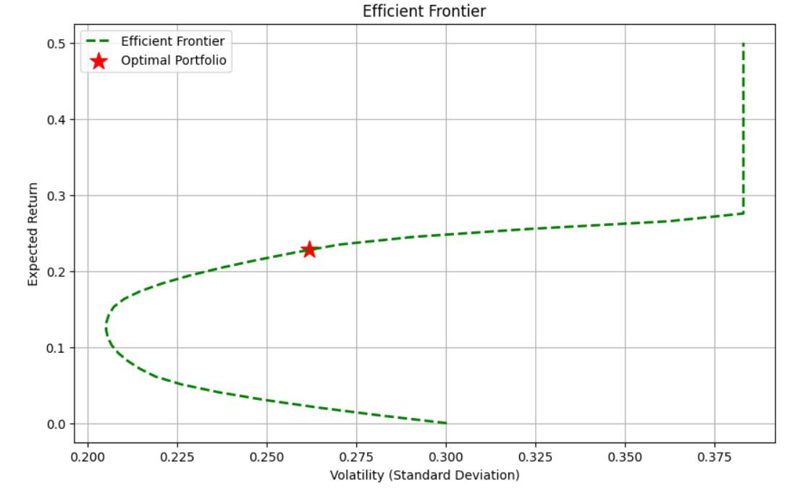
INVESTMENT PREDICTION
The optimal portfolio consists mainly of Japan Tobacco (65.01%) and Mitsui O.S.K. Lines (31.31%), with a small allocation to Erste Bank Group (3.67%). Nissan Motor and Nippon Steel have no allocation, suggesting they wouldn't enhance performance.
With a 22.77% expected annual return, an initial R100,000 investment could yield R22,766 after one year. This comes with a 26.18% volatility, indicating high risk but aligning with the portfolio’s strategy for volatile markets.
A Sharpe Ratio of 0.87 reflects a good balance between risk and reward, though slightly below the ideal threshold of 1.0. Overall, the portfolio is positioned for strong gains with a manageable risk-to-reward ratio.
Calculation: Investment Amount: R100,000 Average Annual Return: Between R22,000 and R30,000 Time Period: 10 years Lower Estimate: Total Earnings = Average Annual Return × Number of Years Total Earnings = R22,000 × 10 = R220,000 Total Amount after 10 years = Initial Investment + Total Earnings Total Amount = R100,000 + R220,000 = R320,000 Upper Estimate: Total Earnings = R30,000 × 10 = R300,000 Total Amount after 10 years = R100,000 + R300,000 = R400,000 Summary: Total Amount after 10 years (lower estimate): R320,000 Total Amount after 10 years (upper estimate): R400,000

Slide 16
RECOMMENDATIONS
Investment Strategies Based on Model Analysis
For Short-Term Traders:
LSTM Model Insights: Focus on short-term factors driving the Nikkei 225.
Corporate Earnings: Pay attention to reports from key companies like Toyota, Sony, and SoftBank.
Exchange Rates: Track yen vs. dollar due to Japan's export-driven economy.
Opportunities: Expected volatility offers several potential large gains.
Risk Management: Critical for navigating volatility.
For Long-Term Investors such as Hiroshi:
Positive Outlook: Prophet model predicts a general upward trend in the Nikkei 225 from 2023 to 2030.
Heavy Allocations Recommended: Supported by government stimulus and low interest rates.
Sector Growth: Focus on automobiles and technology.
Risks: Geopolitical tensions (e.g., China, North Korea) but can be mitigated by:
Diversified Portfolio: Across sectors and asset classes to offset potential risks.
For Risk-Averse Hiroshi:
Portfolio Optimization: Efficient frontier can offer better returns with controlled risk.
High Volatility (27.78%): Requires diversification across sectors and regions.
Diversification: Smooths out returns and reduces the impact of any one asset.
Expected Return (19.89%): Attractive but must balance volatility in the asset allocation strategy.

Slide 17
RECOMMENDATIONS
In summary, by using the predictions from both the Prophet, Effort Frontier and LSTM models, Hiroshi and Akira can develop tailored strategies that align with their risk appetites and investment goals, while effectively navigating the dynamic landscape of the Japanese market.

Slide 18
SOURCES
MacroMicro, n.d. Japan - Stock Indices Forward P/E Ratio. MacroMicro. Available at: https://www.macromicro.me/[Accessed 18 October 2024].
Dividendpedia, 2024. Dividend Calendar of NIKKEI225 in 2024. Dividendpedia. Available at: https://www.dividendpedia.com/ [Accessed 18 October 2024].
Bank of Japan, n.d. Bank of Japan. Bank of Japan. Available at: https://www.boj.or.jp/en/ [Accessed 18 October 2024].
Nikkei Asia, n.d. Nikkei Asia. Nikkei Asia. Available at: https://asia.nikkei.com/ [Accessed 18 October 2024].
Bloomberg, 2024. Nikkei 225 on course for best weekly rally in almost two years. Bloomberg, 12 January. Available at: https://www.bloomberg.com/news/articles/2024-01-12/nikkei-225-on-course-for-best-weekly-rally-in-almost-two-years[Accessed 18 October 2024].
Investopedia, n.d. The Nikkei 225: A Long-Term Perspective. Investopedia. Available at: https://www.investopedia.com/terms/n/nikkei.asp [Accessed 18 October 2024].
Yahoo Finance, n.d. Understanding the Nikkei 225. Yahoo Finance. Available at: https://finance.yahoo.com/quote/%5EN225/ [Accessed 18 October 2024].
The Wall Street Journal, n.d. The Nikkei 225: A guide for investors. The Wall Street Journal. Available at: https://www.wsj.com/market-data/quotes/index/JP/NIK [Accessed 18 October 2024].

